Slide 1
Constants & Pointers
constants, iota, memory addresses, pointers

Slide 2
constants

Slide 3
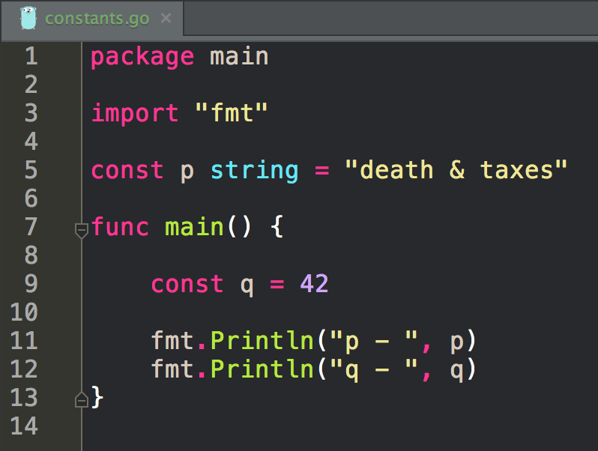

Slide 4
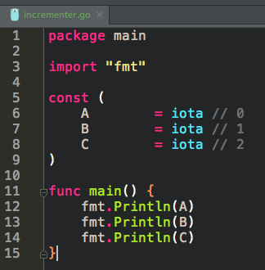

Slide 5
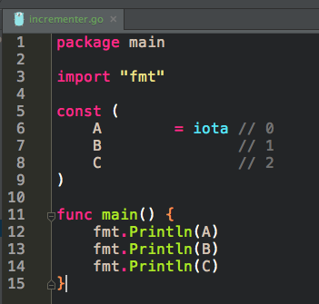

Slide 6
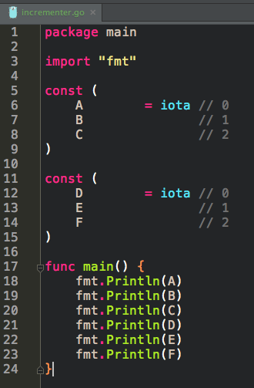

Slide 7
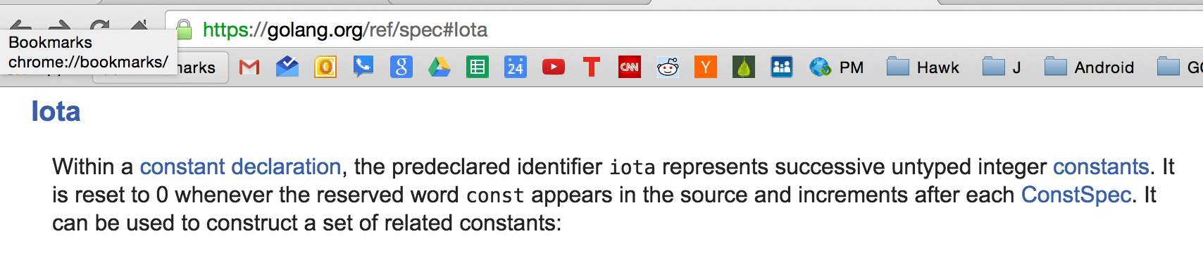
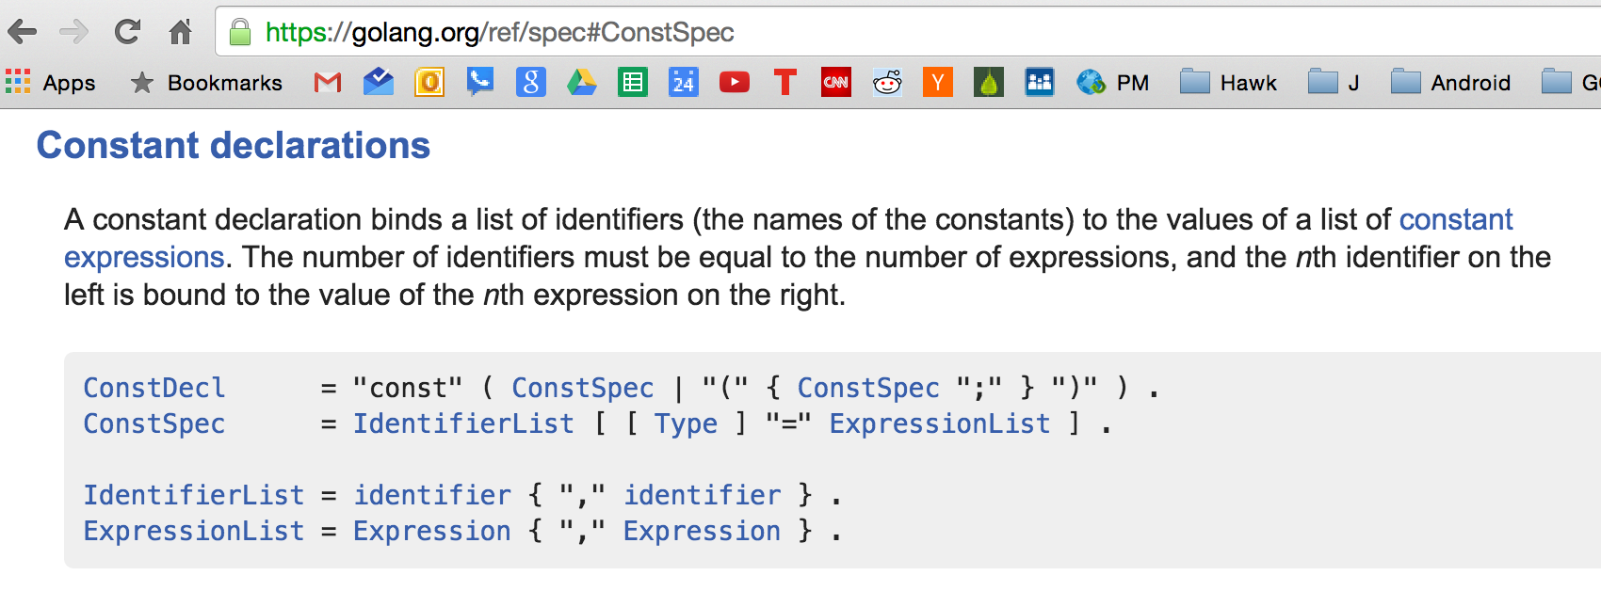

Slide 8
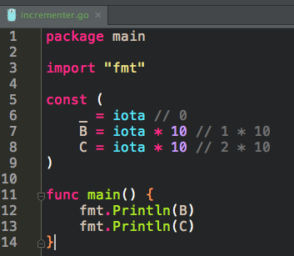

Slide 9
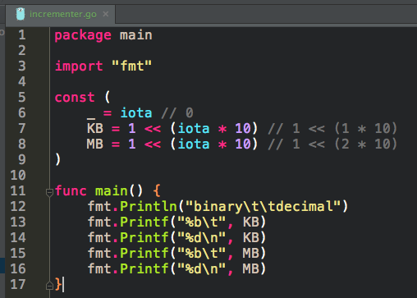
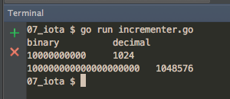

Slide 10
bitwise operations
learn more if you want

Slide 11
exercise
declare a constant of type int
assign it the value of your age
use the constant in a statement

Slide 12
exercise
write some code using iota

Slide 13
memory address
And where do you live?

Slide 14
&
& where do you live?

Slide 15
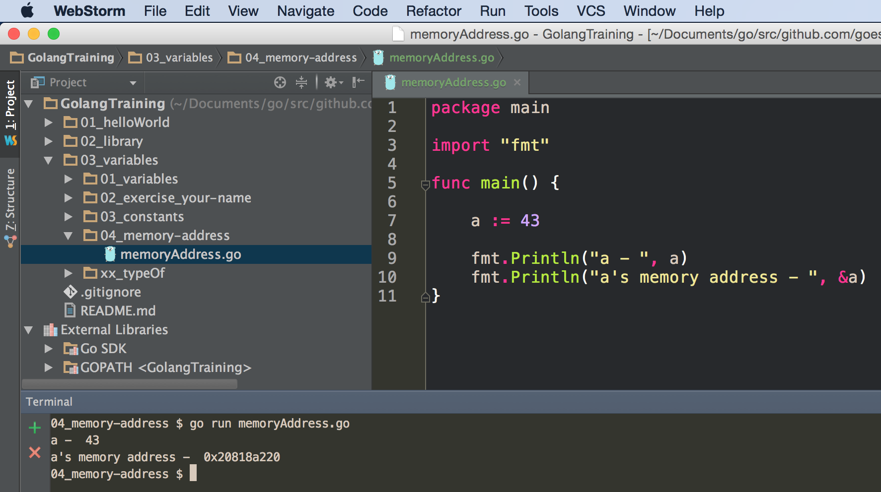

Slide 16
exercise
declare a variable
print the variable’s memory address

Slide 17
memory address
using the memory address

Slide 18
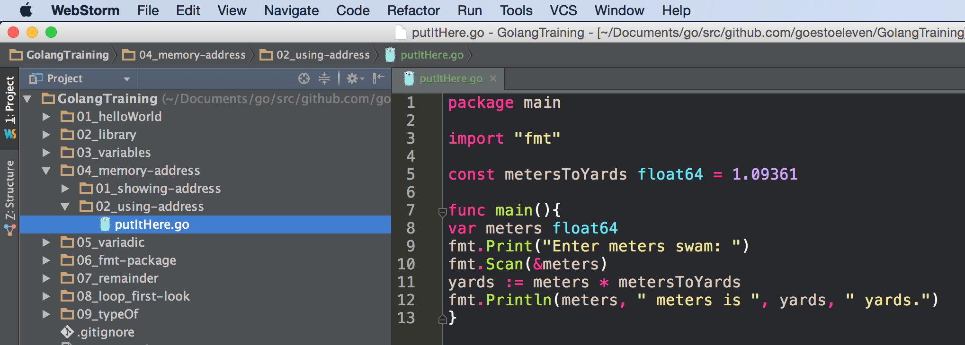

Slide 19
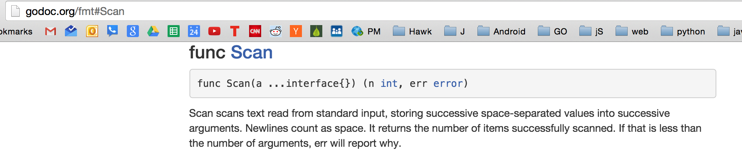

Slide 20
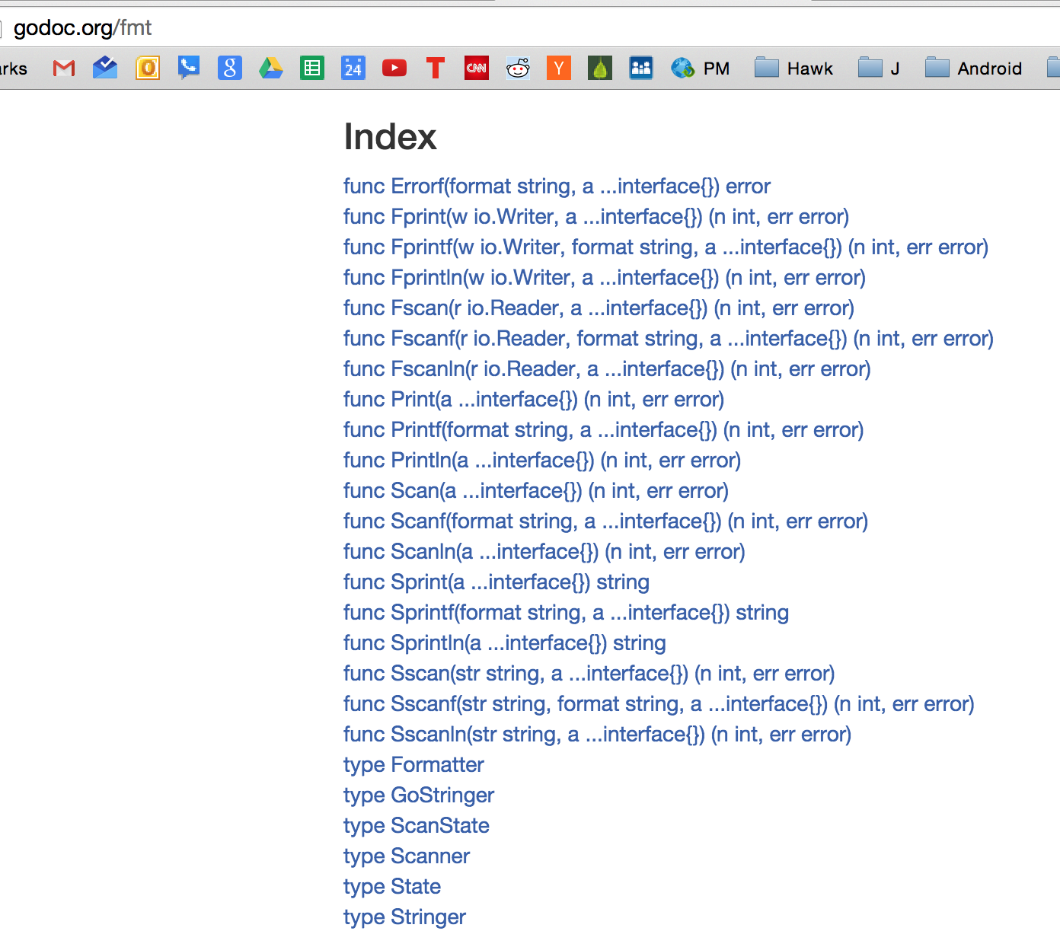
We have been using fmt.Println
fmt.Scan receives input from user
fmt.Sprint prints to a string

Slide 21
exercise
write a program
that receives input from the user
then does something with the input

Slide 22
pointers
pointing to memory addresses

Slide 23
*
*The asterisk symbol is used in books to reference something more, is it not?

Slide 24
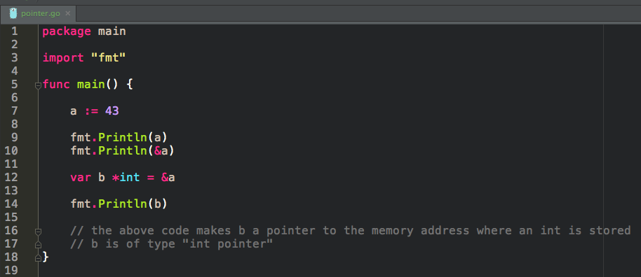
this is how we store, or reference, a memory address
the variable b is storing a memory address, and in that memory address, an int is stored
b is of type “int pointer”

Slide 25
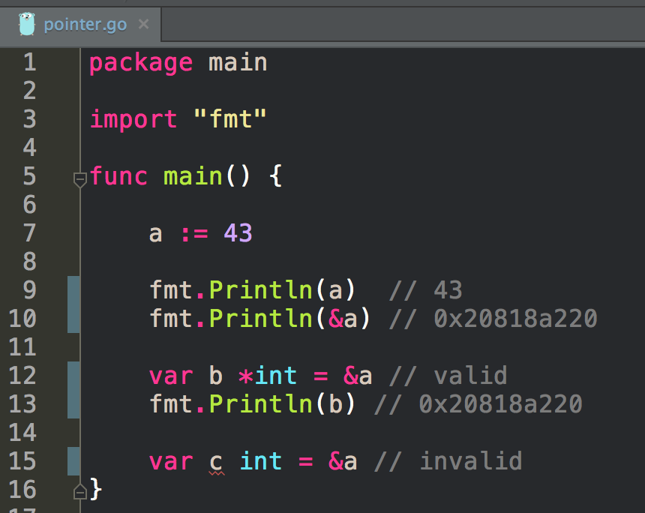
invalid code:
we’re saying on line 15 that c is of type int but then we’re assigning it a memory address, not an int

Slide 26
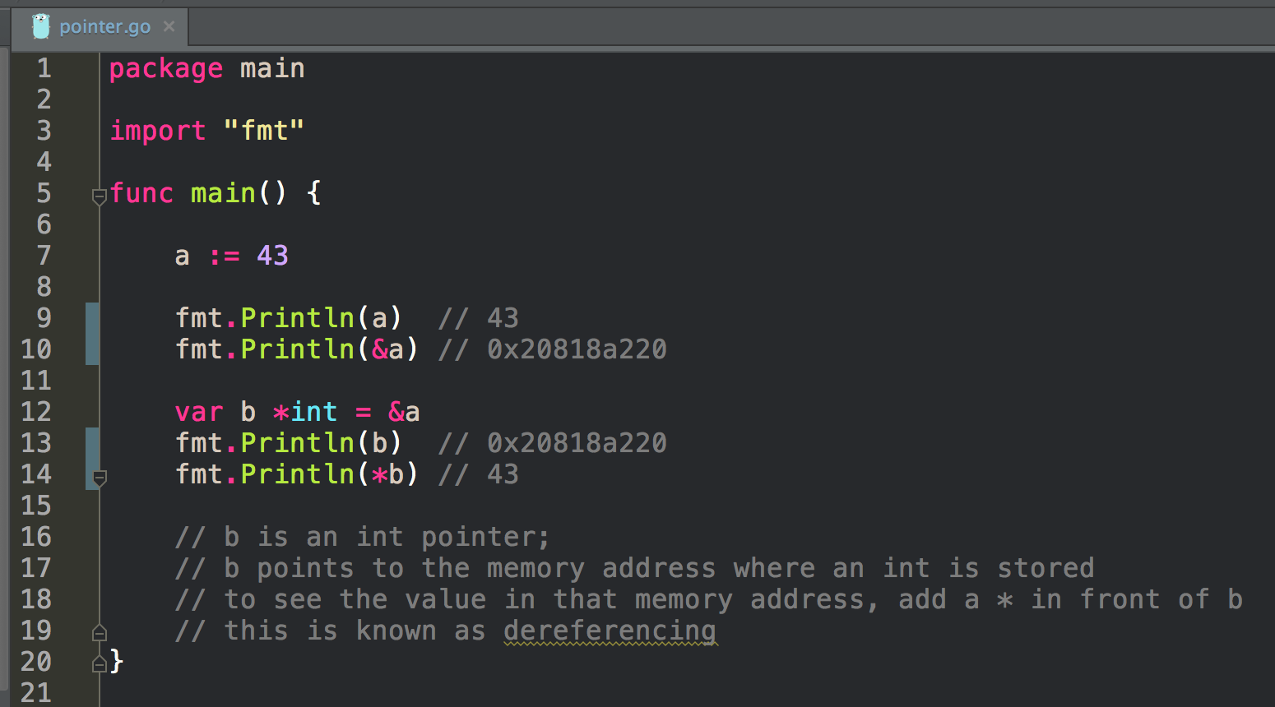
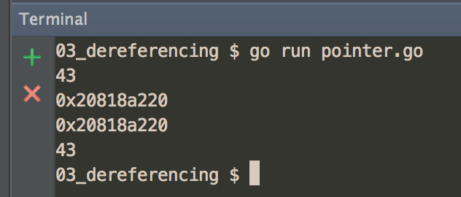
this is how we dereference
the variable b is storing a memory address
adding an asterisk in front of b says, “Show me the value in the memory address you’re storing.”

Slide 27
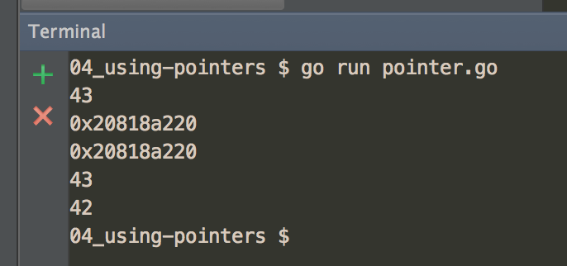
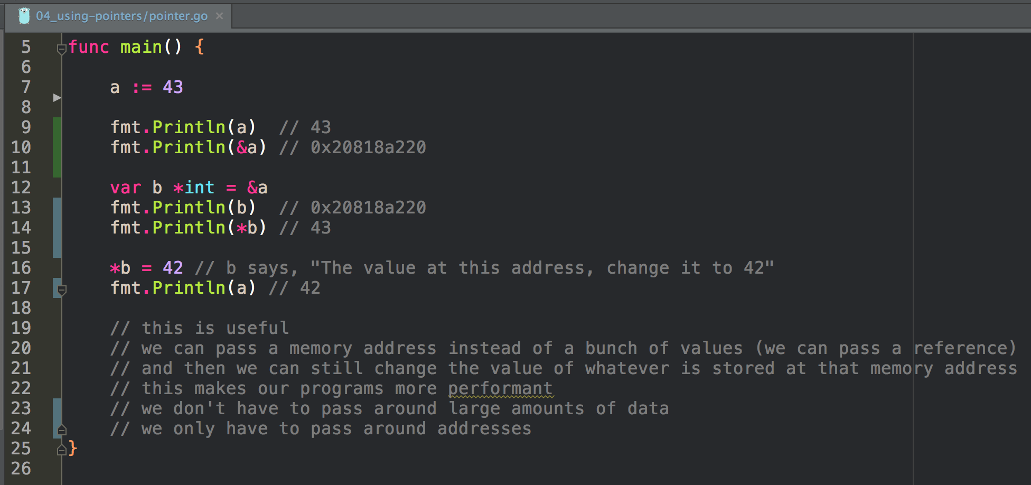

Slide 28
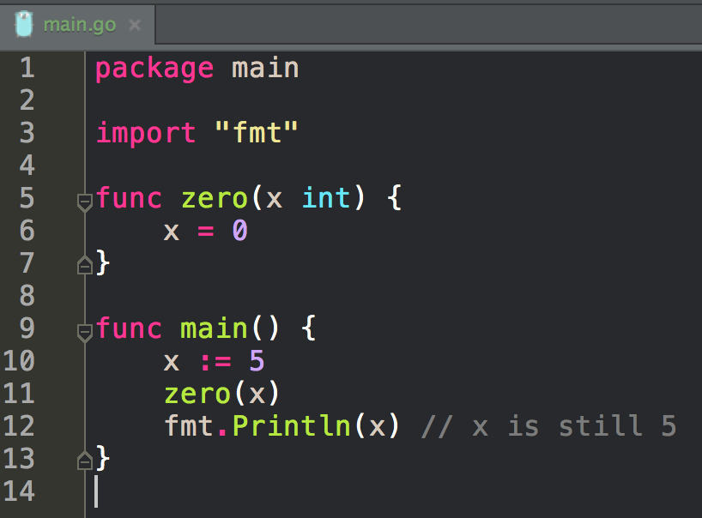
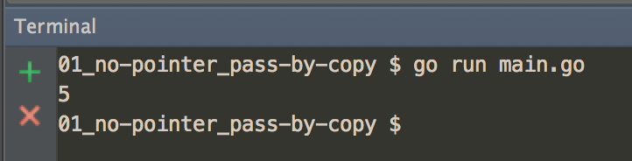
Pass By Copy
A copy of the variable is passed into the function

Slide 29
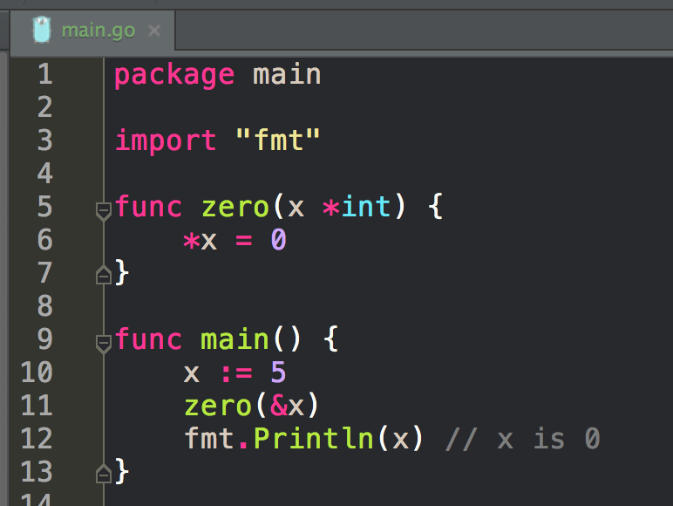
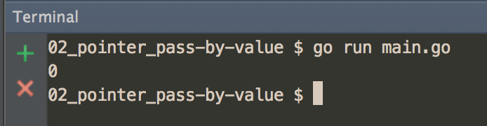
Pass By Value
The memory address of the variable is passed into the function
the value of the variable can now be changed

Slide 30
exercise
write a program
that uses memory addresses and pointers

Slide 31
Review
constants
iota
bitwise operations
memory address
&
And where do you live?
pointers
*
referencing / dereferencing

Slide 32
Review Questions

Slide 33
bitwise
Research and then explain how bitwise operations work.
Write a program that uses bitwise operations and use screenshots of your code and output in your explanation.

Slide 34
Memory Addresses & Pointers
Describe the role that memory addresses and pointers play in go programming.
How might you use a memory address?
How might you use a pointer?
Why is it useful to use a pointer?
What is the relationship between a memory address and a pointer?

